Slide 1
NATIONAL CONFERNECE 2020 Presenting with Zoom
Presented by: Miriam Bennett

Slide 3
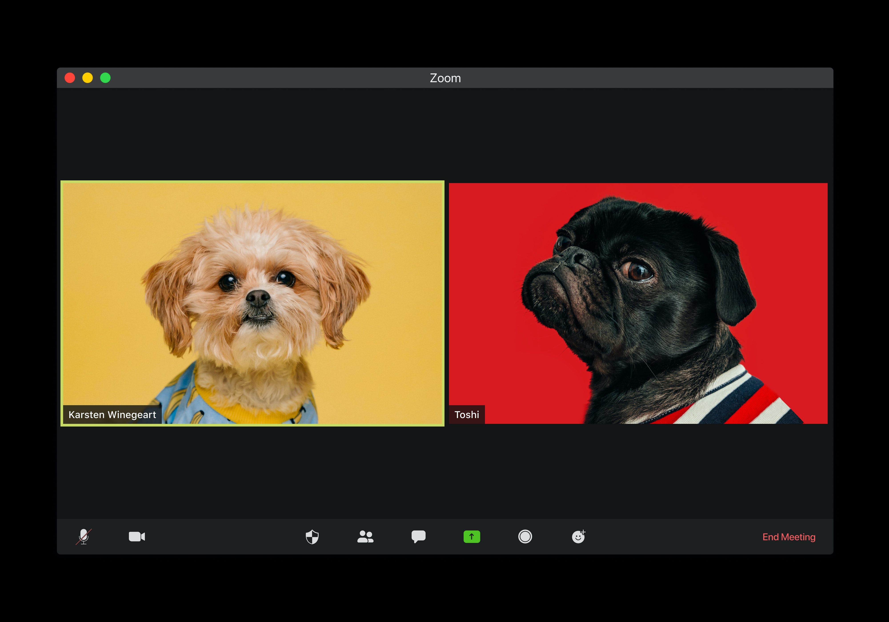
Today:
Do
Ask
Discuss
Practice
but…
Practice
as
Host

Slide 4



Activity 1 – About you
How are you feeling about presenting at a virtual conference?
Tell me with Reactions.
Go to the Participants window and choose, yes, no and Raise Hand. Or use the ‘more’ icon at the bottom to select an icon.

Slide 5

Activity 2 – Using chat
What questions do you have that you would like answered in this session?
Ask a question in the chat.
Presenting and monitoring the chatroom at the same time will be challenging.
Select Chat (Alt+H) to have text chats and Participants (Alt+U) to see who else is in the room and access icons to communicate.
1.

Slide 6

Activity 3 Where are you from?

Slide 7
Activity 2 Where are your grandparents from?

Slide 8
Activity 4 Whiteboard
Use the whiteboard annotation tools to add a text word or a draw an image representation of how you’re feeling about presenting at a virtual conference.
Or just have a scribble.

Slide 9
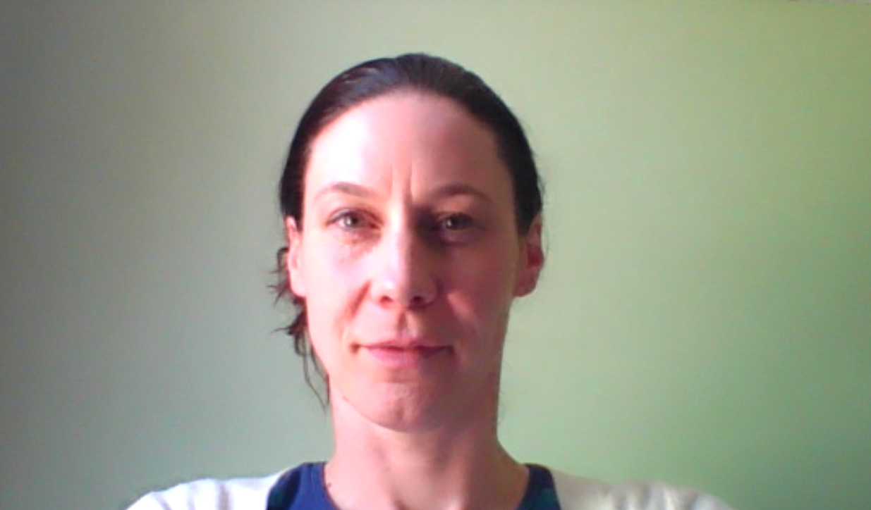

Managing screens, screen share and breakout rooms

Slide 10
Hosting & Managing windows
Tips for hosting:
Use 2 screen if you can
Clean your desktop
Open anything you want to share (video, audio, webpages) before the session starts
Close all unnecessary applications windows
Put your phone on silent and close the door
Join 10 minutes early to set up
Audio is really important! External microphones are generally better than internal ones. Options: headset, Bluetooth mic, apple earbuds, desktop mic

Slide 11
Keyboard shortcuts are your friend
Mac | PC | Function
Command + Tab | Alt + Tab | Switch between application windows on your computers (bring Zoom forward or back)
Space bar | Space bar | Temporarily unmute
 | F6 | Navigate among Zoom popup windows
Command + Shift + H | Alt + H | Display/hide in-meeting chat panel
Command + Shift + U | Alt + U | Display/hide participants panel
Option + Y | Alt + Y | Raise/Lower hand
Command + Shift + S | Alt + S | Start/Stop screenshare

Slide 12

Activity 5 – Play time
In breakout rooms take turns to:
Share a screen
Share a ppt in presenter mode
Share a video with sound
Share the whiteboard
Share a file in the chat
Help guide screen sharing

Slide 13
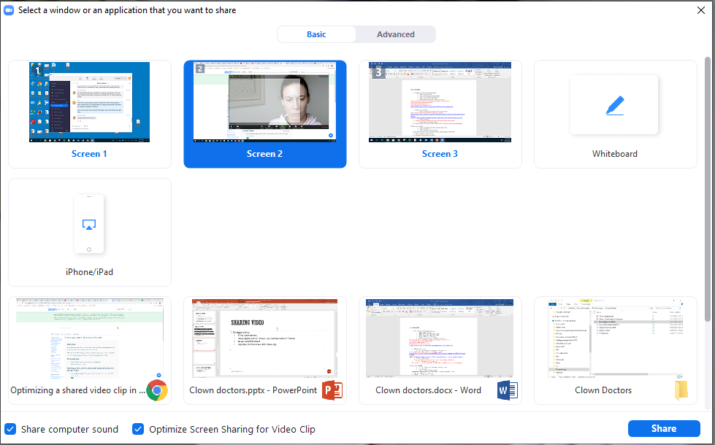
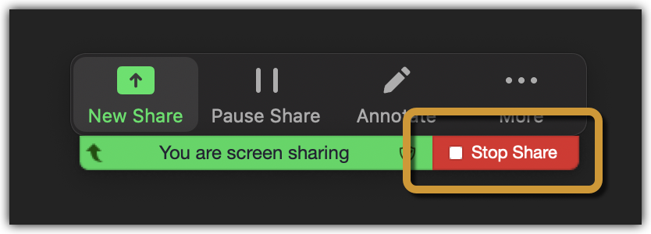
Screen share
You can share one application (e.g. word or ppt) or a whole screen
The green line indicates which screen you are sharing
Stop Share is at the top of the screen you are sharing
Help guide screen sharing a ppt

Slide 14
Sharing video
To share video:
Click Share Screen
Select application or Screen (e.g. youtube video or imovie)
Share computer sound
Optimize Screen Sharing for Video Clip
Sharing computer sound Zoom support guide
2.

Slide 15
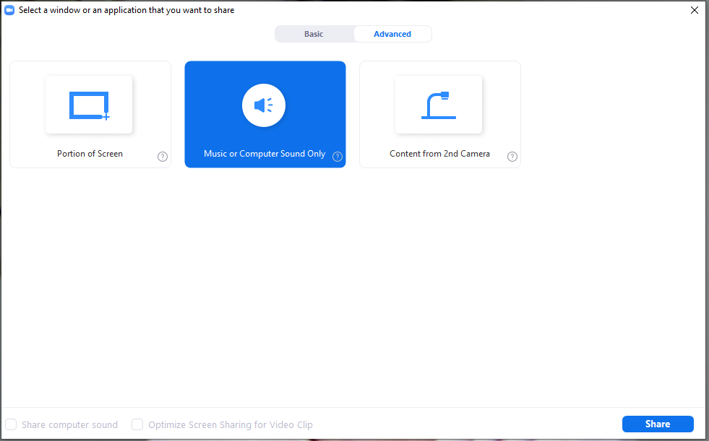
Sharing Audio only and Portion of Screen
To share music only:
Click Share Screen
Click Advanced
Select Music or Computer Sound Only
Note: you can still speak over the top but may need to adjust the volume of your mic in audio settings in the meeting.
Select Portion of Screen if you only have one monitor and want to share part of it only.

Slide 16
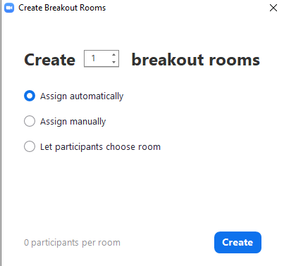

Breakout rooms
Very simple to use and effective!
Assign automatically, manually or participants choose
Groups are remembered or you can recreate
Hosts and co-hosts can move between rooms
Set a time limit
Broadcast a message to all
Remember to share instructions before participants leave the main room
3.

Slide 17
Activity 5 – Play time
In breakout rooms take turns to:
Share a screen
Share a ppt in presenter mode
Share a video with sound
Share the whiteboard
Share a file in the chat

Slide 18
Questions?
Thank you

